Slide 1
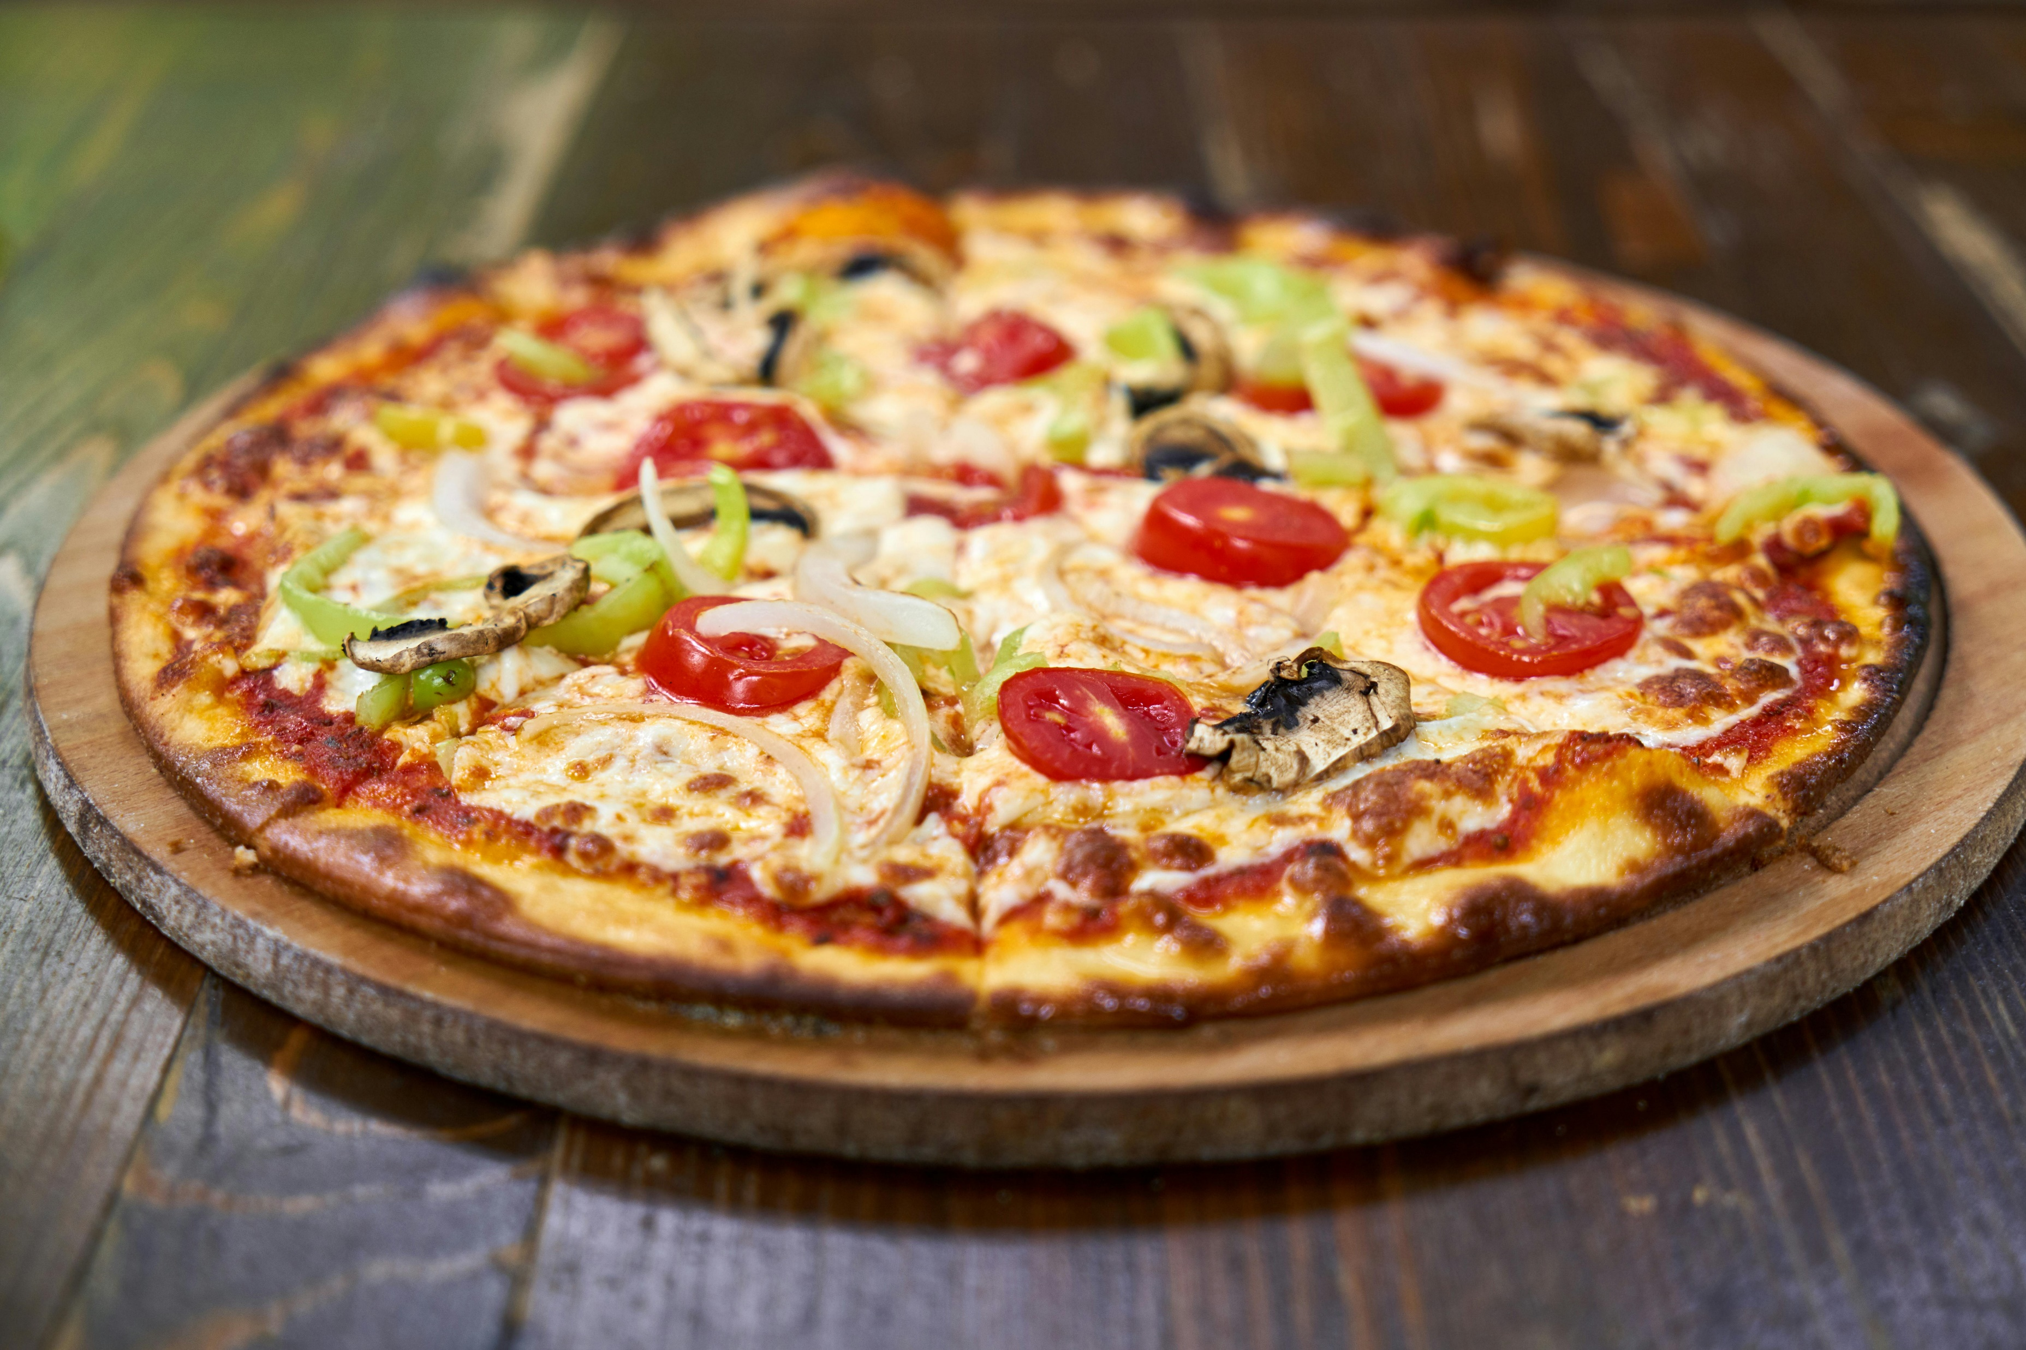
PIZZA SALES ANALYSIS

Slide 2
Dataset Overview
Dataset contains valuable information that could help us optimize our operations, boost sales, and enhance customer satisfaction. Here's a quick rundown of what you can expect from the dataset:
Month and Day: We have meticulously recorded the month and day of each order, allowing us to analyze customer behavior and identify potential peak hours.
Pizza Details: Each entry includes comprehensive details about the pizzas ordered, including their types, sizes, quantities, prices, and the tantalizing ingredients that create an unforgettable culinary experience.

Slide 3
Analysis
Customer Traffic Analysis: Analyzing how many customers visits each day and exploring whether certain day experience higher sales.
Bestselling Pizzas: Analyzing the data to find out which pizzas are the most popular among our customers. Identifying bestsellers can inform our marketing strategies and help us focus on promoting these crowd favorites.
Revenue and Seasonality: Calculating the total revenue generated over the year to get an overall picture of our financial performance. Additionally, investigating whether there are any seasonal patterns in sales to plan for peak and slow periods.
Menu Optimization and Promotions: Using the data to identify pizzas that are underperforming or receiving little attention.

Slide 4
Key Questions Explored
Total Revenue: Total Revenue generated over the period.
Average Order Value: Average order value throughout the year.
Total Pizza Sold: Total number of Pizzas sold.
Total Orders: Total Orders placed.
Average Pizzas Per Order: Average Pizzas ordered per order.
Daily Trend for Total Orders: By days of the week, trend for sales throughout the year.
Monthly Trend for Total Orders: Monthly Trend for Total Orders to analyze seasonality.
% of Sales by Pizza Category: Percentage of total sales, each 4 Categories contributes.

Slide 5
% of Sales by Pizza Size: Percentage of total sales, each of 5 sizes Contributes.
10. Top 5 Best Sellers by Revenue, Total Quantity & Total Orders: Top 5 Best selling Pizza by Revenue, Total Quantity & Total Orders.
11. 5 Lowest Sellers by Revenue, Total Quantity & Total Orders: 5 lowest selling Pizzas by Revenue, Total Quantity & Total Orders.
Number of Customers each day & Busiest hours: Number of customer served each day and busy operating hours.
13. Average Orders & Pizza per Day: Average Orders placed per Day & Pizzas sold per day

Slide 6
Summary of Findings
Most occupied Days & Month:
Days-Orders are highest on Friday & Saturday evenings
Month-Orders are highest on January & July
Sales Performance:
Category-Classic contributes maximum to Sales & Total Orders
Size-Large pizza contributes maximum to Sales
Best Sellers:
Revenue-Thai Chicken Pizza contribute maximum to Revenue
Quantity-Classic Deluxe Pizza contributes maximum to Total Quantities
Total Orders-Classic Deluxe Pizza contributes maximum to Total Orders
Lowest Sellers:
Revenue-Brie Carre Pizza contribute minimum to Revenue
Quantity-Brie Carre Pizza contribute minimum to Total Quantities
Total Orders-Brie Carre Pizza contribute minimum to Total Orders

Slide 7
Recommendations
Based on these findings, some possible recommendations for increasing the pizza sales and customer satisfaction are:
Offer promotions and discounts to customers who order more pizzas or larger sizes, to increase the average order value and the average pizzas per order.
Review the sales performance of each pizza category and decide whether to keep, modify, or replace them with new and innovative products.
Conduct a brief survey among the customers who have purchased the low-selling pizza categories and find out the reasons for their low interest. This will help to improve the existing products or introduce new ones that match the customers’ preferences and expectations.
Adjust the supply and demand of the pizza according to the busiest days and times, and the seasonal variations, to optimize the efficiency and profitability of the pizza sales.

Slide 8
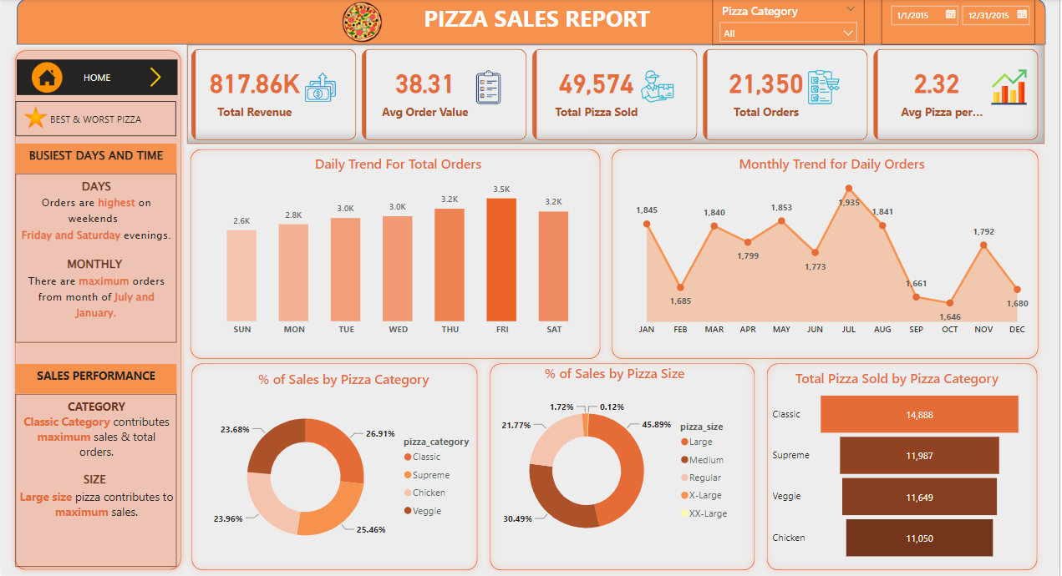

Slide 9
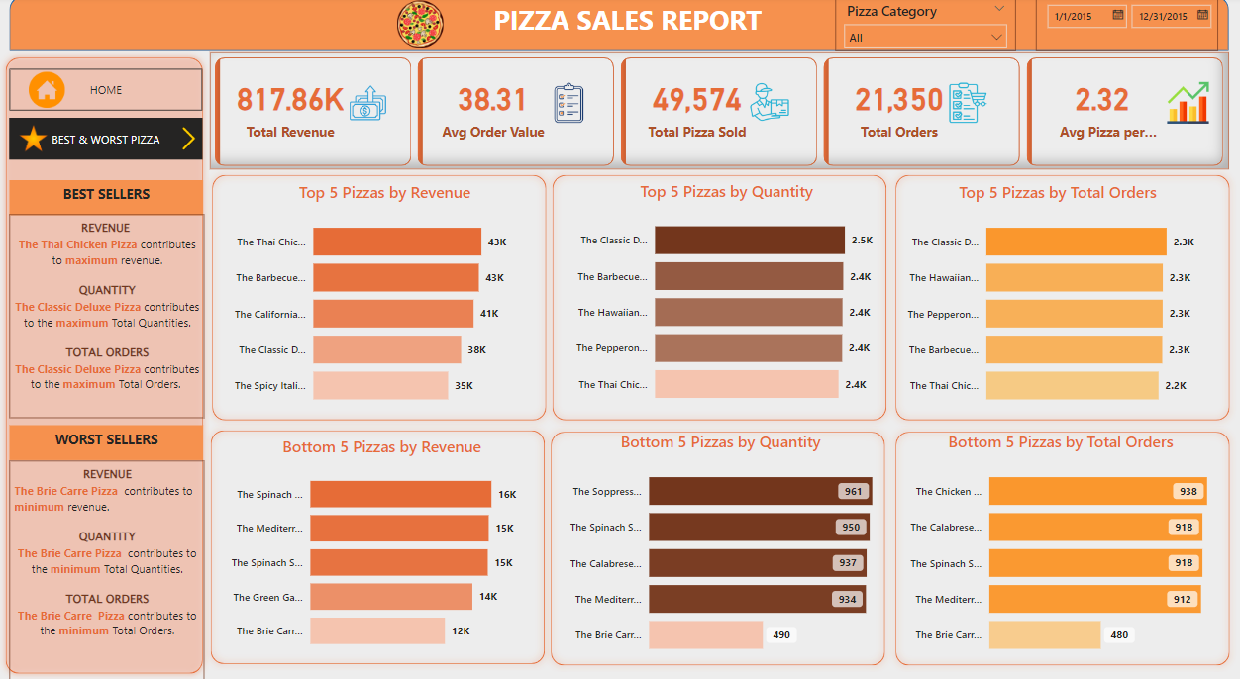

Slide 10
Conclusion
The Pizza Sales Dashboard provides a comprehensive overview of the pizza sales for the company. It indicates that there are some areas of improvement, such as the average order value, the pizza category, the pizza size, and the customer satisfaction. By implementing the recommendations suggested in this report, the company can increase the pizza sales and customer satisfaction.

